Slide 1


Terraform – A Primer
27.04.2019
Max Melcher
Cloud Solution Architect, Microsoft

Slide 2


Maximilian Melcher
Max is a Cloud Solution Architect working at Microsoft in Munich, Germany. Max is a specialist in Azure focused on Application Development. In the entire DACH region he consults large enterprise customers and helps them succeed on their digital journey.
Twitter: @maxmelcher Blog: melcher.it Email: Max.Melcher@microsoft.com www.microsoft.com

Slide 3

Terraform – A Primer
Notes:
Introduction
192 slides => 10
Basics to get you going
Not included is CI/CD – that’s homework for you guys

Slide 4


Terraform
https://www.terraform.io/
HashiCorp
Open Source Software
https://github.com/hashicorp/terraform
https://github.com/terraform-providers/terraform-provider-azurerm
Written in GO
https://golang.org/
Notes:
Created/maintained by Hashicorp
OSS, hosted on Github
GoLang – single executable
I am a BIG fan

Slide 5
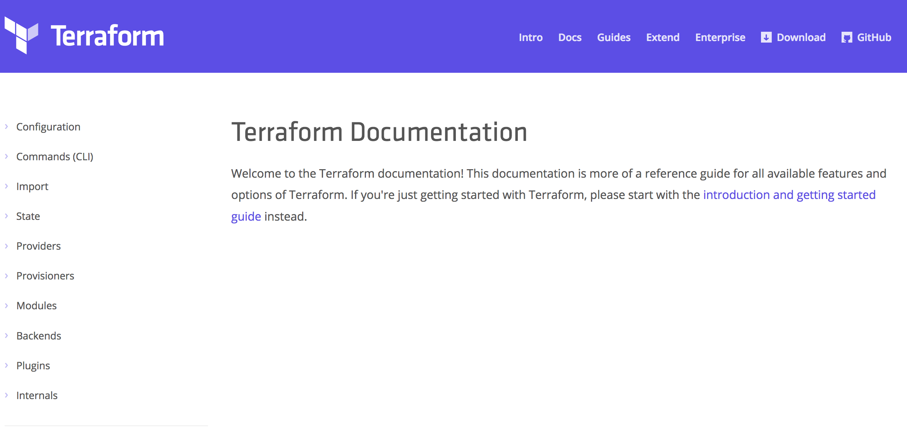
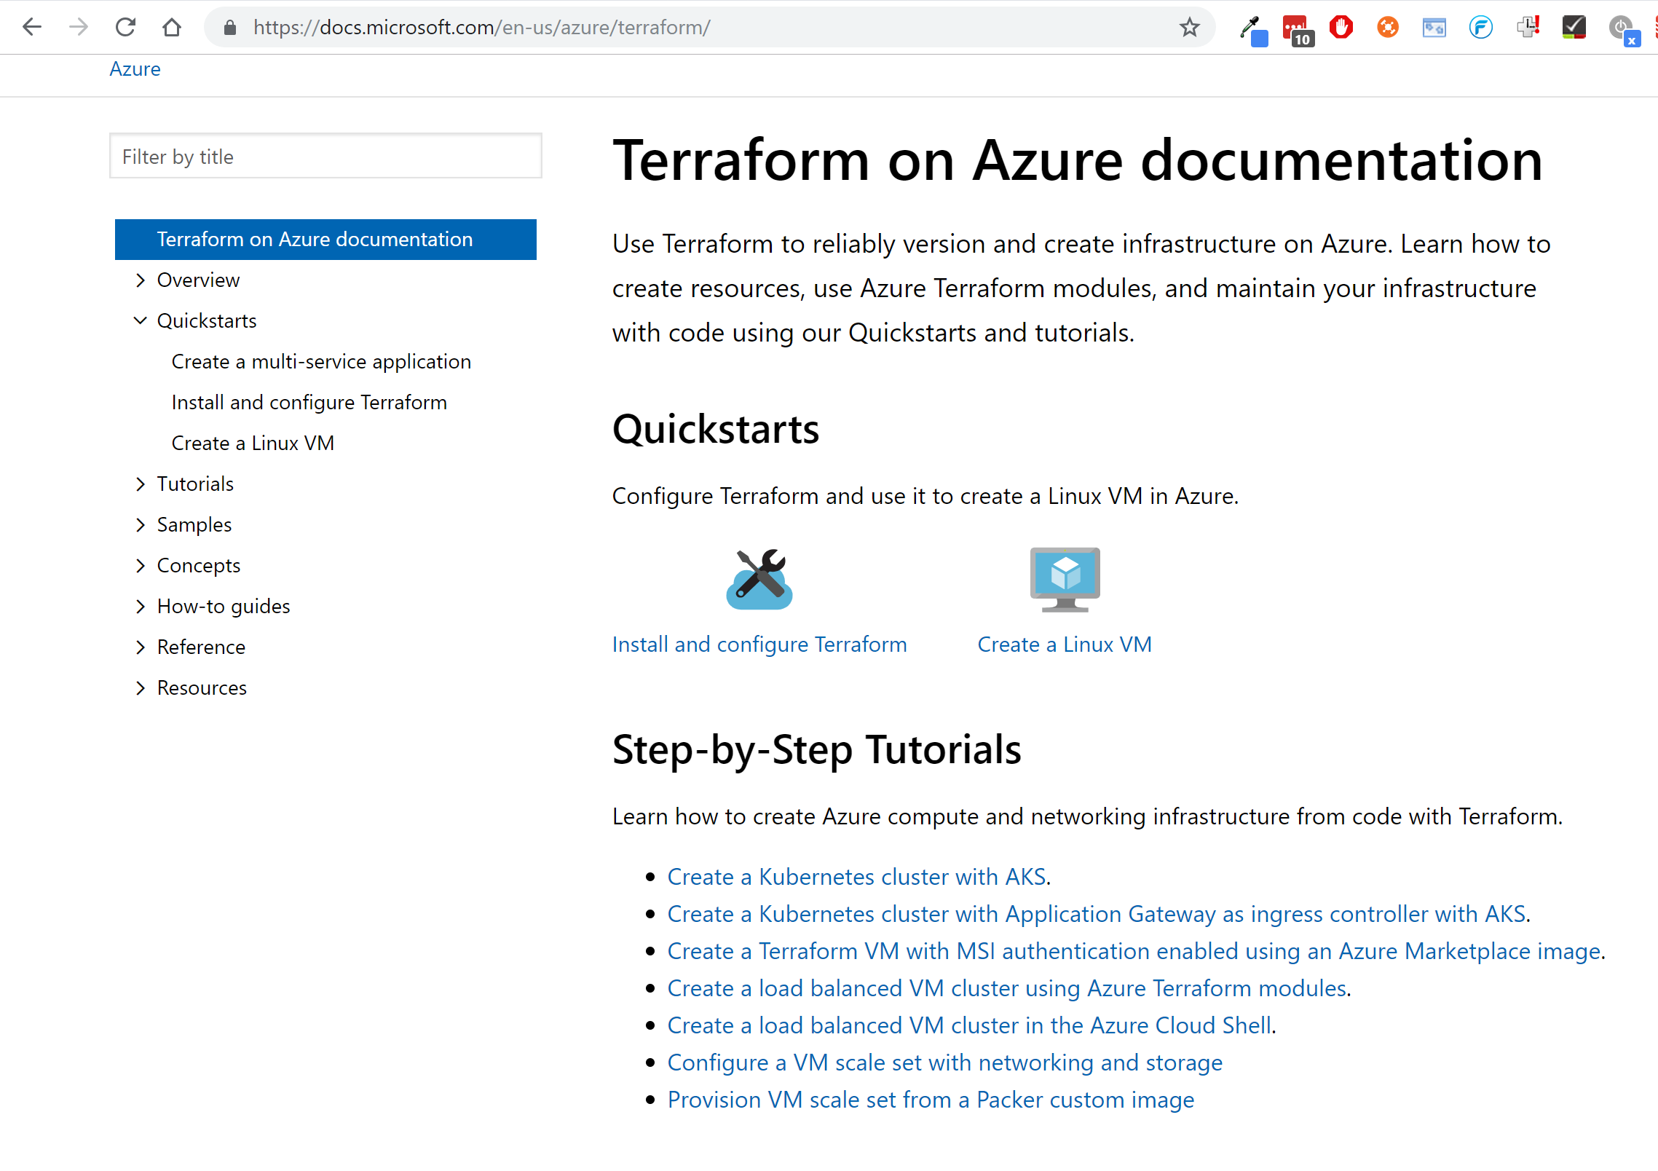
Terraform Docs / Azure Docs
https://www.terraform.io/docs
https://docs.microsoft.com/en-us/azure/terraform/
Notes:
Great documentation – two times.
Constantly being updated – accepts pull requests

Slide 6
Hashicorp Configuration Language
Human-readable configuration (HCL) is designed for human consumption so users can quickly interpret and understand their infrastructure configuration.
<filename>.tf
HCL includes a full JSON parser for machine-generated configurations.
<filename>.tf.json
https://www.terraform.io/docs/configuration/syntax.html
https://github.com/hashicorp/hcl
Notes:
Best thing of it -

Slide 7
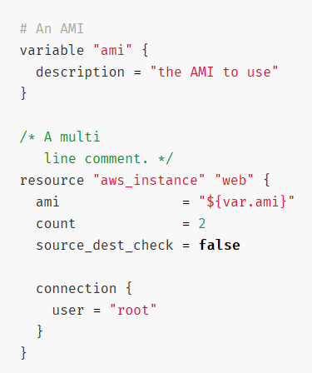
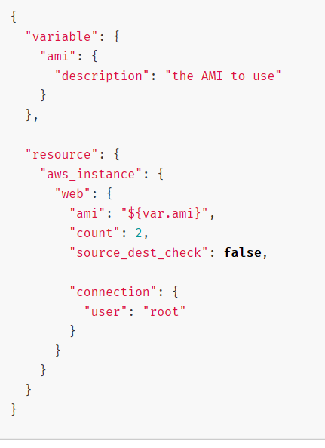
Terraform HCL vs JSON Syntax

Slide 8
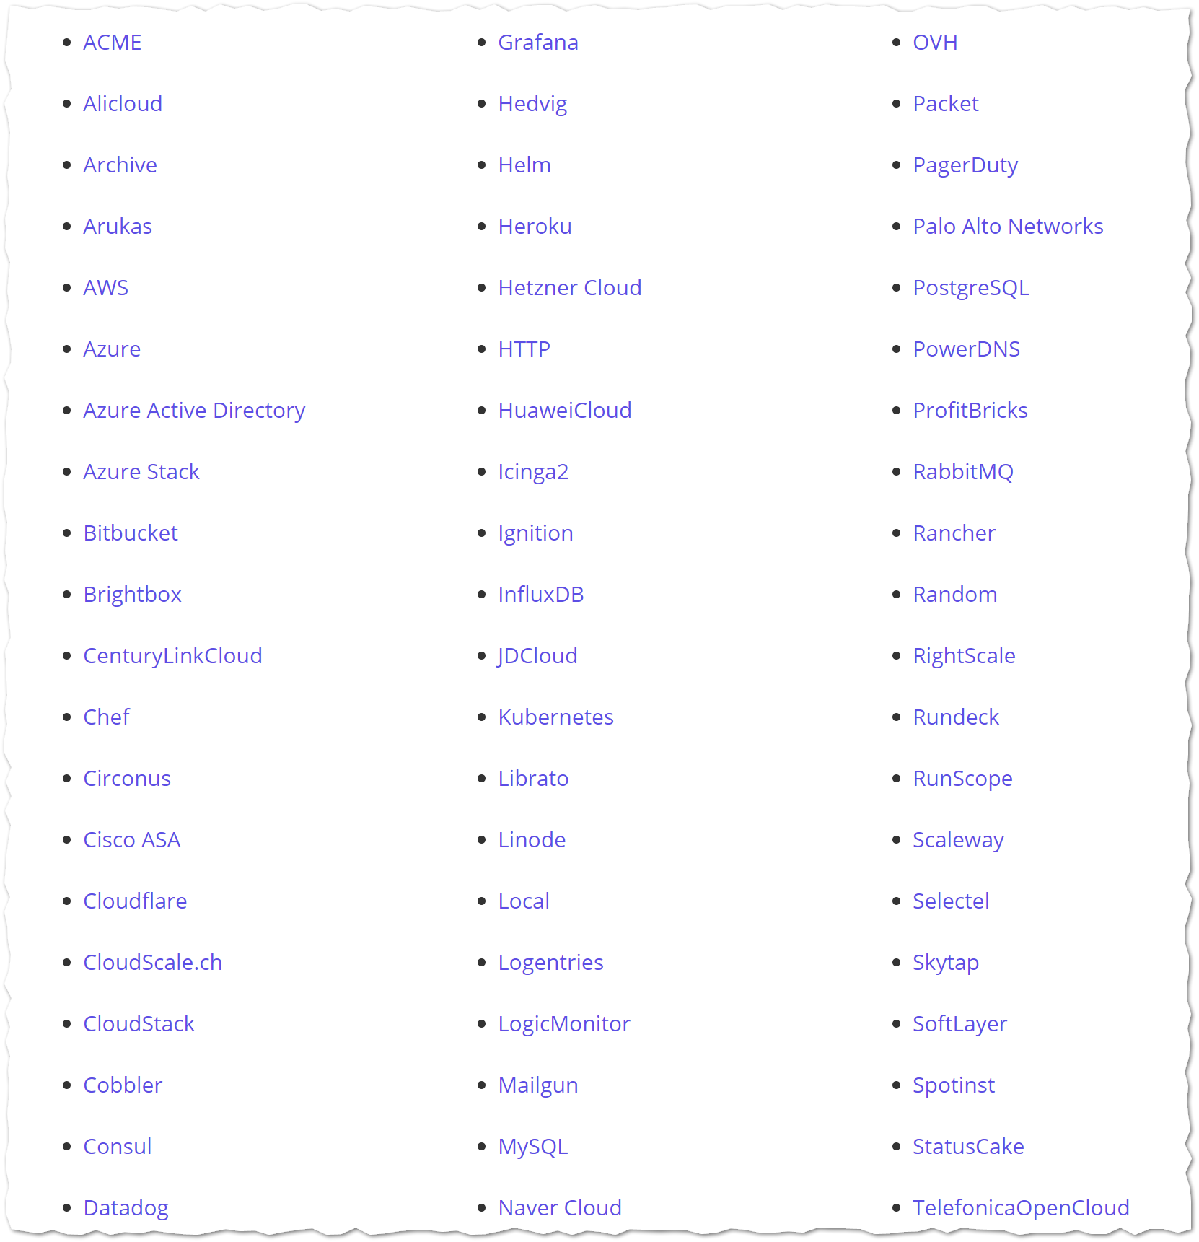
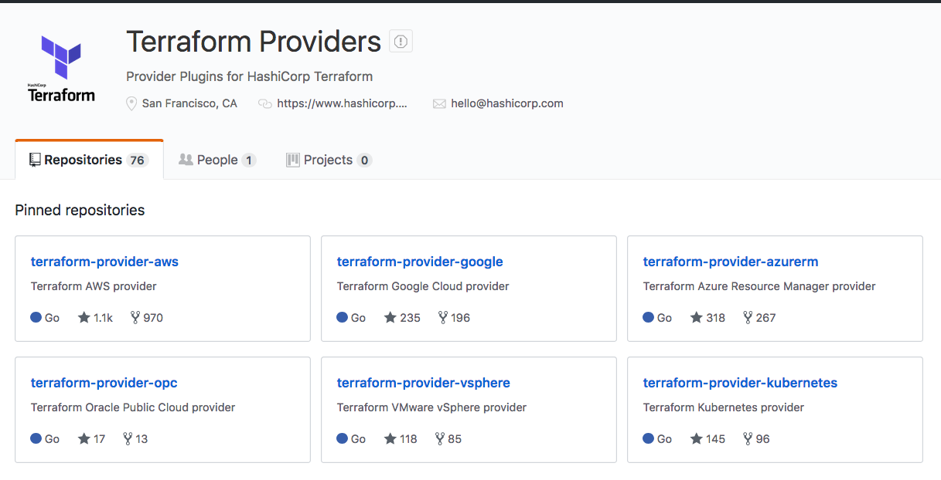
Terraform Providers
Notes:
Terraform Providers are in their own Github Organization
Terraform only pulls in what is needed based on your configuration `terraform init`
Aka.ms/terraform

Slide 9
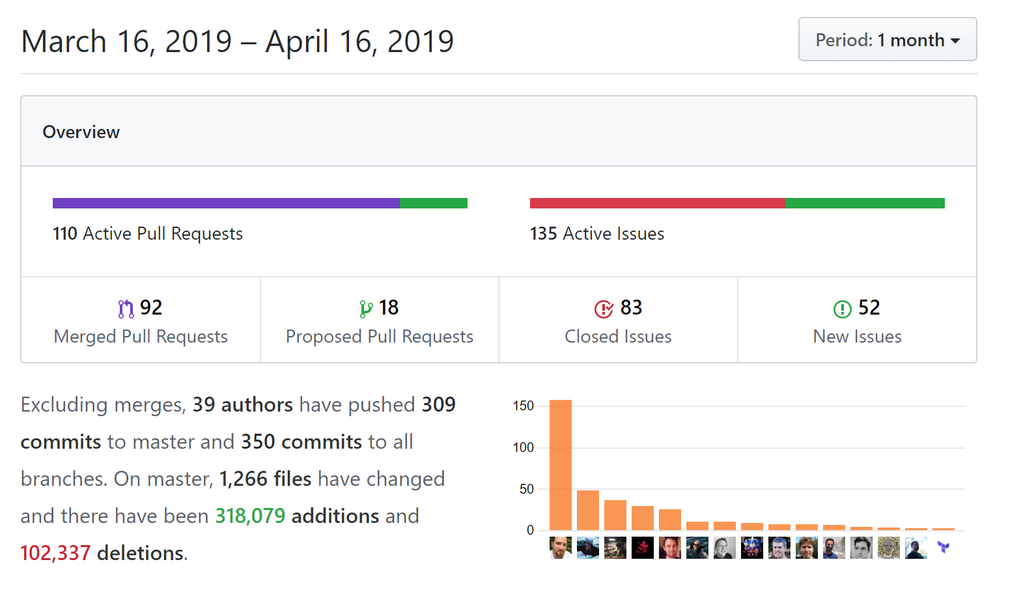
Azure Provider
100+ resources
Very active code base
Frequent releases
Jan 2018 -> v1.0.0
May 2018 -> v1.4.0
…
May 2019 -> v1.23.0
April 2019 -> v1.24.0
https://github.com/terraform-providers/terraform-provider-azurerm
Notes:
100+ resources, more added every week.
Active code base – 47 Merged PR in 1 month
Frequent releases - 10 official releases in 5 months
Actively see what is being progress (Submit an Issue if you have a problem)
Tom Harvey => Azure Saturday

Slide 10
Terraform in Action

Slide 11
THANK YOU
Azure Saturday 2019, May, 18th azuresaturday.de

